Slide 1
TOY FACTORY
GAME
Professor Harrington
It-516
BY:
Ramprasad battula
Dinesh reddy gopannagari Venkata
Venkata ashok reddy kommireddy
Siva prasad reddy kusam
Sagar reddy yalla

Slide 2
AGENDA
BASIC INTRODUCTION ABOUT JAVA DIGRAPH LOGIC
USAGE OF JAVA DIGRAPH
PROJECT INTRO
LOGIC OF GAME AND DIGRAPH IN GAME USED
SOURCE CODE
STATISTICS OF GAME
CONCLUSION

Slide 3
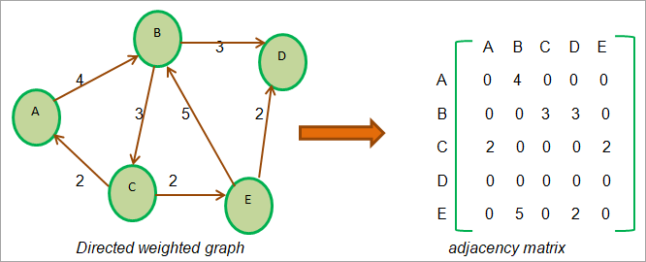
BASIC INTRODUCTION DIGRAPH LOGIC
Digraph
The library "edu.princeton.cs.algs4"
Vertices and edges.
Degree of a Vertex
Notes:
A digraph, or directed graph, is a type of graph data structure in which edges have a direction and can only be traversed in one direction.
In Java, the library "edu.princeton.cs.algs4" provides a Digraph class for creating and manipulating digraphs.
The Digraph class allows for the creation of a new digraph with a specified number of vertices and edges, as well as the addition of edges between vertices.
It also provides methods for determining the in-degree and out-degree of a vertex, finding the reverse of a digraph, and determining if a digraph is acyclic.

Slide 4
USage OF DIGRAPH IN JAVA
The main use of a digraph in Java is to represent directed relationships between objects or entities. Some examples of how digraphs can be used in Java include:
Representation
Modeling
Dependencies
Graph Algorithms
Notes:
Representing a network of computers and the connections between them.
Modeling a transportation system, with vertices representing cities or stations and edges representing routes between them.
Representing the dependencies between different classes or methods in a software system.
Modeling a web of relationships in a social network, with vertices representing individuals and edges representing relationships such as friendships or followers.
Modeling a workflow or process, with vertices representing tasks or stages and edges representing the flow of control between them.
Used in many graph algorithm such as topological sorting, cycle detection, shortest path, longest path and many more.
The Digraph class in the "edu.princeton.cs.algs4" library provides an implementation of a directed graph data structure in Java, and provides various methods for creating, manipulating, and analyzing digraphs.

Slide 5


PROJECT INTRO
Notes:
Toy Factory is a board game that allows players to experience the thrill of running their own toy factory. The objective of the game is to build the most efficient and profitable toy factory while avoiding traps and taking advantage of bonuses along the way.
The game is based on the theme of a toy factory and uses a directed graph (digraph) to map out the different spaces on the board and the paths that players can take between those spaces. The players will roll a die to move on the board and encounter traps, bonuses, roadblocks, and weather conditions based on their positions.
The game will end when all players run out of fuel or reach the destination. The game is designed for 1-4 players and is fully automated, with no decision points for players. The game will automatically play and will provide statistics for players at the end, ensuring that the game is properly random.
It will show the number of times each space was landed on, the number of times each trap/bonus was taken, the number of turns for each player, and average and count of the possible "rolls" of the die or "spins" of the spinner.

Slide 6

DEMO IMAGE

Slide 7
LOGIC OF GAME AND DIGRAPH IN GAME
Usage of Digraph class in the "edu.princeton.cs.algs4"
Starting game
Traps, bonuses, road blocks, and weather conditions, which will affect the players' progress.
The game ends when all players run out of fuel or reach the destination.
Notes:
The logic of the Toy Factory game is based on players moving around a board with spaces that represent different parts of a toy factory. The board is modeled using a directed graph, or digraph, which allows for the representation of different paths and directions that players can take. The game uses the Digraph class in the "edu.princeton.cs.algs4" library to create and manipulate the directed graph.
At the start of the game, players are placed at the starting position on the board and are given a set amount of fuel. They will then take turns rolling a die to determine how many spaces they will move on the board. The players will move along the edges of the digraph, encountering different spaces that represent different parts of the toy factory.
The traps will cause the players to lose fuel or fall back to a previous position, while the bonuses will give the players extra fuel or advance them to a higher position. The road blocks will cause the players to lose a turn, and the weather conditions will affect the players' visibility and mobility.
The player who reaches the destination first or has the most fuel left wins the game. The game also provides statistics at the end to ensure that the game is properly random, such as the number of times each space was landed on, the number of times each trap/bonus was taken, and the number of turns for each player.

Slide 8

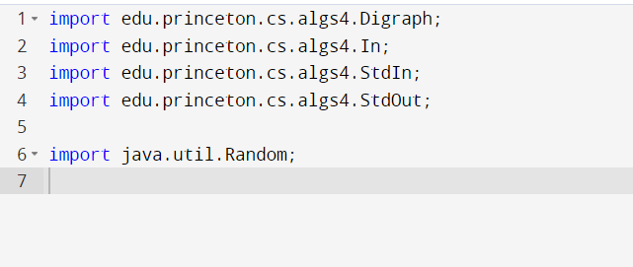
SOURCE CODE EXPLANATION
LIBRARIES

Slide 9
Libraries explanation
The above code imports four classes from the "edu.princeton.cs.algs4" package which is a library of useful data structures and algorithms in Java.
“Digraph” class
"In" class
"StdIn"
"StdOut"
"java.util.Random"
Notes:
The "Digraph" class provides an implementation of a directed graph data structure in Java, and provides various methods for creating, manipulating, and analyzing digraphs. It's used to create the directed graph of the game which represents the different spaces on the board and the paths between them in a directed manner.
The "In" class is used for reading data from files. It's used to read in the node table from a text file, this text file contains the information about the game board and its edges.
The "StdIn" class is used for reading data from standard input. It's not used in this code, but it can be used for reading input from the user in the game.
The "StdOut" class is used for writing data to standard output. It's used to print the output of the game, such as player positions, roll results, trap/bonus encounters, etc.
The last line imports the "java.util.Random" class, which is used to generate random numbers. This class is used to randomly generate the number of players, traps and bonuses in the game, the weather conditions and the road blocks.

Slide 10
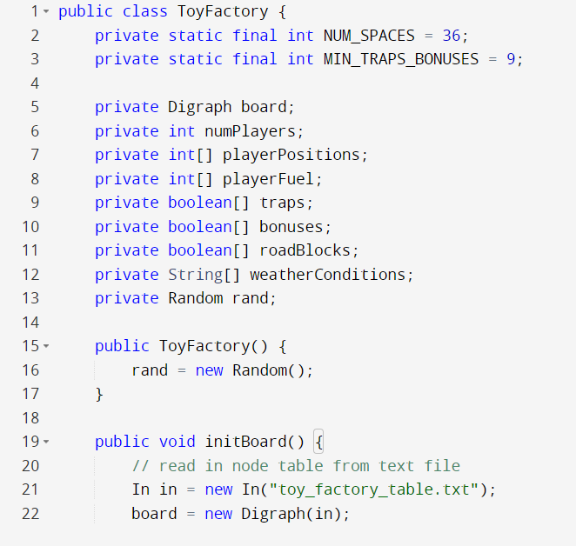
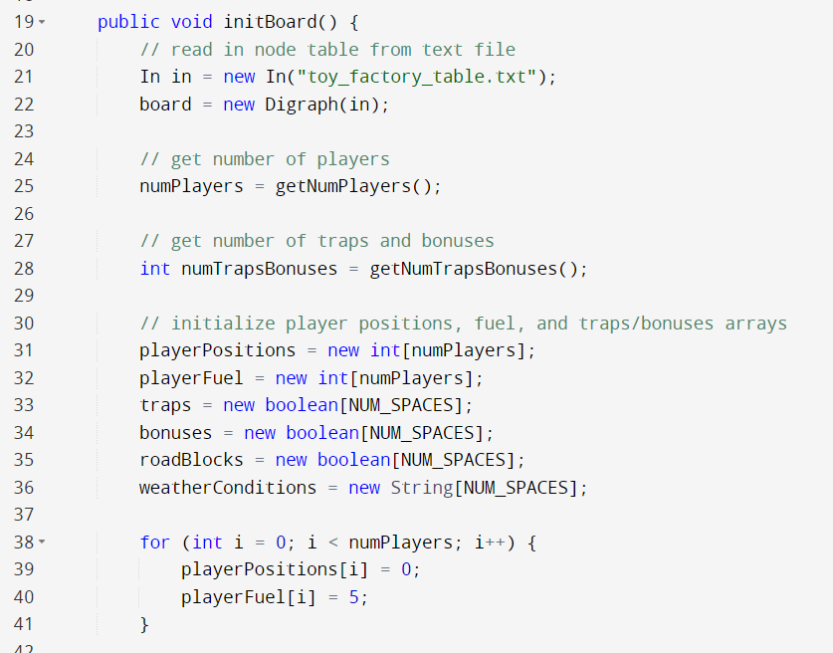
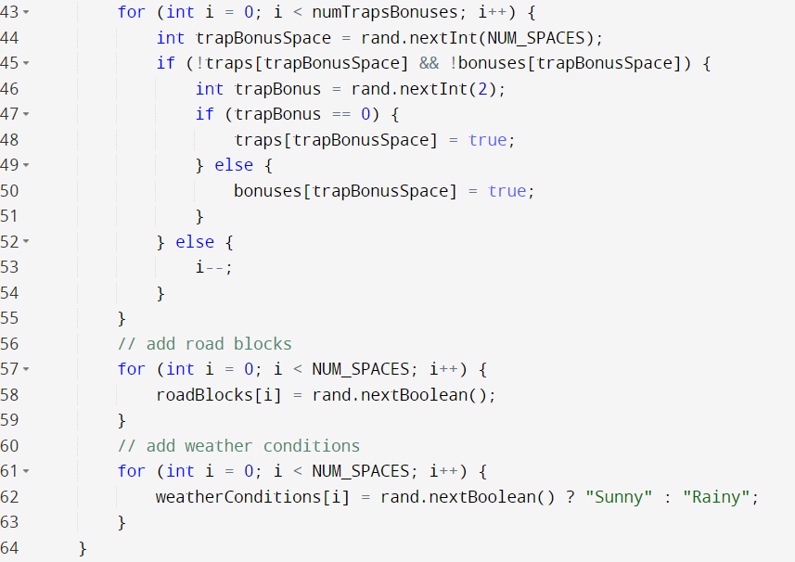
Source code explanation
TOY FACTOR CLASS

Slide 11
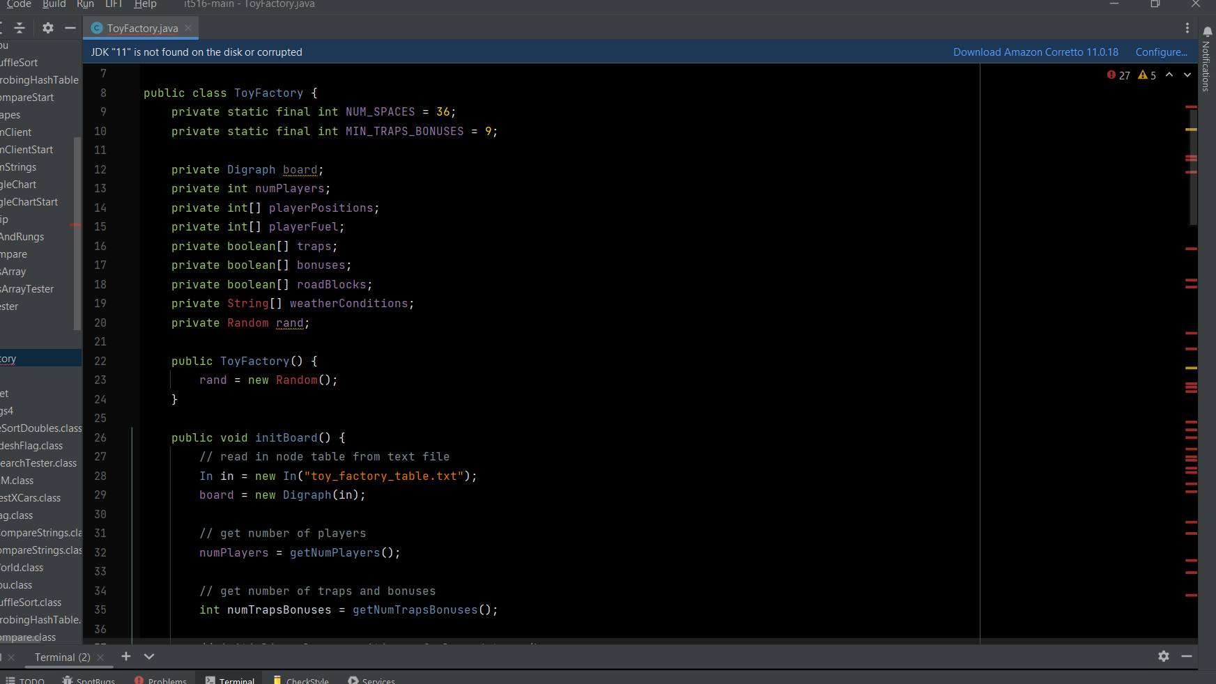
TOY FACTORY CLASS EXPLANATION
Notes:
This code defines the main class "ToyFactory" of the game. It contains various fields that store the game's state and logic.
The first two fields are "NUM_SPACES" and "MIN_TRAPS_BONUSES". They are "final" and "static" which means they are constant and can be accessed without creating an object of the class. NUM_SPACES is set to 36 which represents the number of spaces on the game board. MIN_TRAPS_BONUSES is set to 9 which represents the minimum number of traps and bonuses on the game board.
The "Digraph board" field is an instance of the "Digraph" class that we imported earlier. It's used to store the directed graph of the game board.
The "numPlayers" field stores the number of players in the game.
The "playerPositions" field is an array of integers which stores the current position of each player on the game board.
The "playerFuel" field is an array of integers which stores the current fuel level of each player in the game.
The "traps", "bonuses", "roadBlocks" and "weatherConditions" fields are arrays of booleans. They store whether a space on the game board has a trap, bonus, road block or weather condition respectively.
The "Random rand" field is an instance of the "Random" class. It's used to generate random numbers throughout the game.

Slide 12
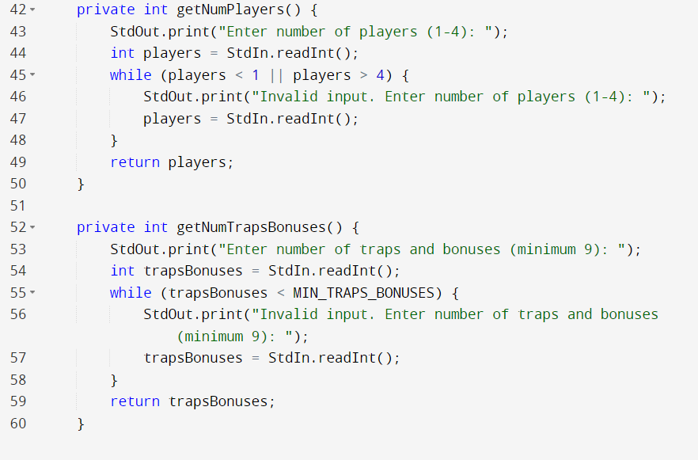
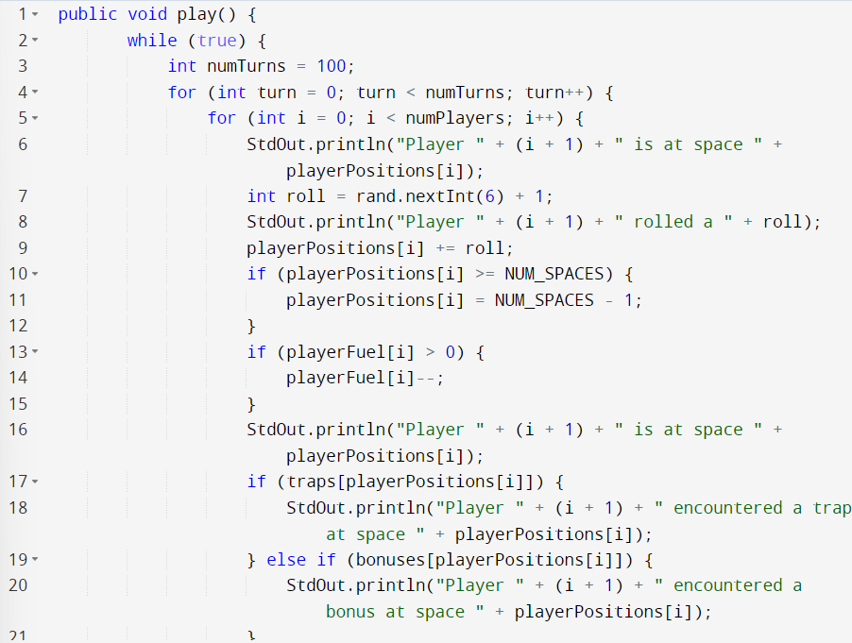
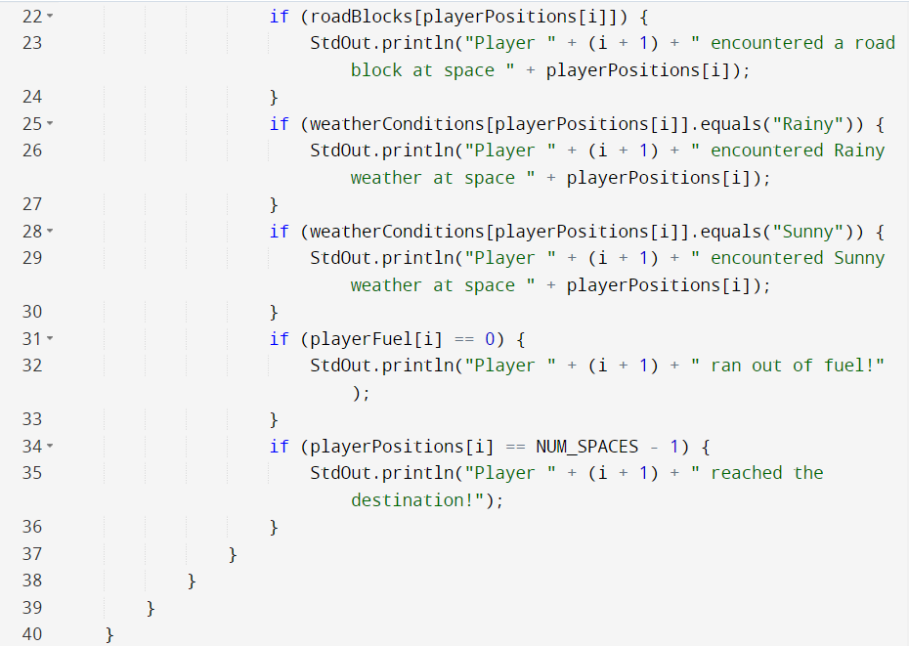
Source code explanation
PLAY, GETNUMPLAYERS, GETNUMTRAPSBONUESES
Notes:
The play() method is the main game loop for the Toy Factory game. Inside the loop, the code simulates 100 turns of the game.
In each turn, the code iterates through each player and updates their position, fuel, and encounters with traps, bonuses, road blocks,
and weather conditions based on a random roll of a die. The code also checks if the player has run out of fuel or reached the final destination, and outputs the appropriate message.

Slide 13
Play, getnumplayers, getnumtrapbonueses explanation
The getNumPlayers() and getNumTrapsBonuses() methods are helper methods that prompt the user to enter the number of players and the number of traps and bonuses, respectively. The methods validate the input to ensure that the number of players is between 1 and 4, and the number of traps and bonuses is at least 9. These values are later used to initialize the game board.

Slide 14
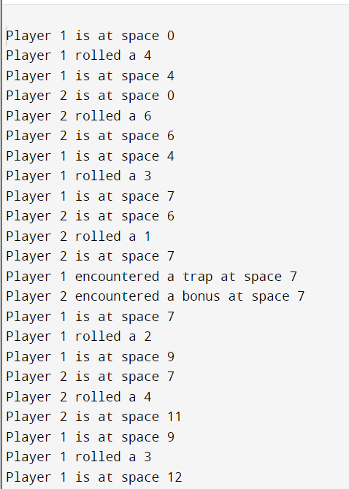
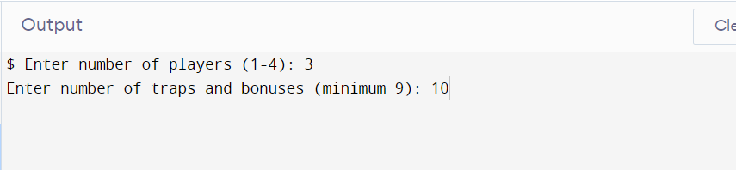
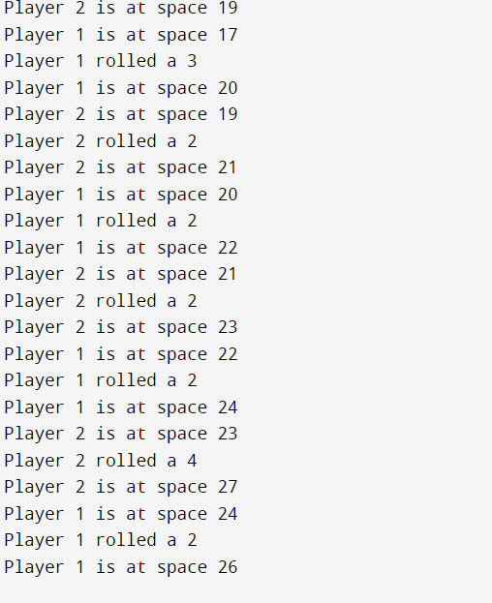
STATISTICS OF GAME (OUTPUT)

Slide 15
conclusion
In conclusion, the toy factory game is a simulation of a board game where players navigate through a factory to reach the end goal. The game uses a digraph data structure to represent the layout of the factory and the movement of the players.
Notes:
The game also includes elements such as traps, bonuses, road blocks, and weather conditions to add an element of unpredictability and challenge for the players. The game is implemented using the Java programming language and makes use of various libraries such as algs4 and random.
The game can be easily customized to change the number of players, number of traps and bonuses, and other factors, to create different variations of the game. Overall, the toy factory game is a fun and engaging way to explore the use of digraphs in game development.

Slide 16
References
Prisner, E. (2014). Game theory : through examples (Ser. Classroom resource materials). Mathematical Association of America. Retrieved January 25, 2023, from INSERT-MISSING-URL.
Chopra, R. (2015). Java programming. New Age International Pvt. Retrieved January 25, 2023, from https://search.ebscohost.com/login.aspx?direct=true&scope=site&db=nlebk&db=nlabk&AN=2706814.
Schildt, H. (2011). Java (8th ed., Vol. , the complete reference /). McGraw-Hill.
Java. (2022). Cabi Compendium, Compendium. https://doi.org/10.1079/cabicompendium.108714
Prudhomme, G. (2020). Java programming applications (E-book). Arcler Press. Retrieved January 25, 2023, from INSERT-MISSING-URL

